Slide 1
Introduction to Data Science
Section 08

Slide 2
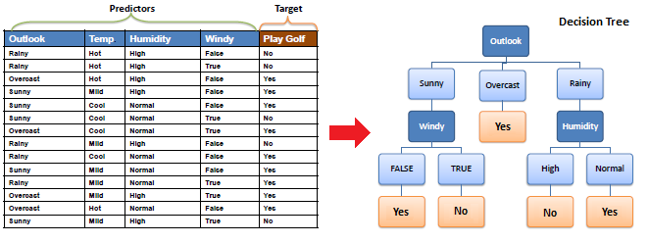
Decision Tree
https://www.saedsayad.com/decision_tree.htm

Slide 3
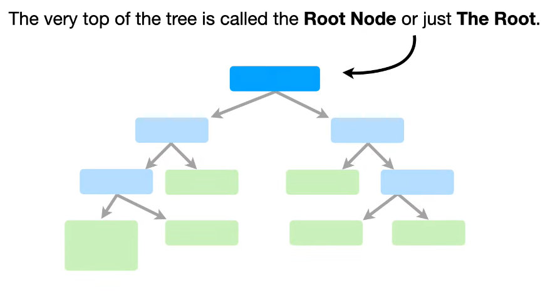
Root Node

Slide 4
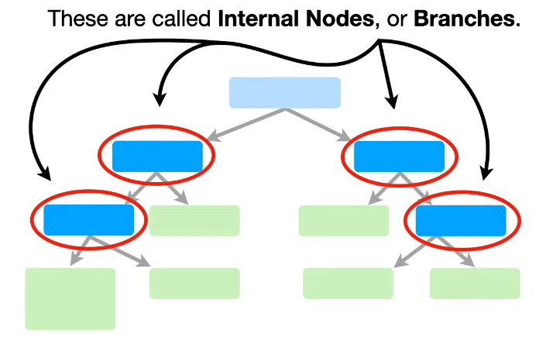
Decision Node/ Internal Node

Slide 5
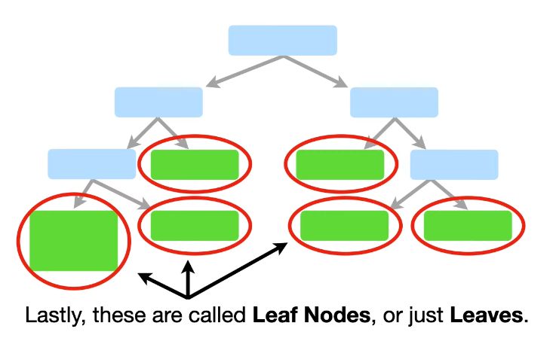
Leaf/ Terminal Node

Slide 6
Decision Tree
A decision tree is a flowchart-like structure in which:
internal node represents a decision on an attribute
branch represents the outcome of that decision
leaf node represents a class label (for classification) or a continuous value (for regression).

Slide 7
How to build a decision tree? Youtube
Decision and Classification Trees, Clearly Explained!!!
StatQuest with Josh Starmer
https://www.youtube.com/watch?v=_L39rN6gz7Y
Has a cool intro song, play the first 10 seconds for fun

Slide 8
Random Forest
Random Forest is an ensemble machine learning algorithm that builds upon the concept of decision trees.
It creates multiple decision trees during training and merges their outputs
Benefit: more accurate and stable predictions.

Slide 9
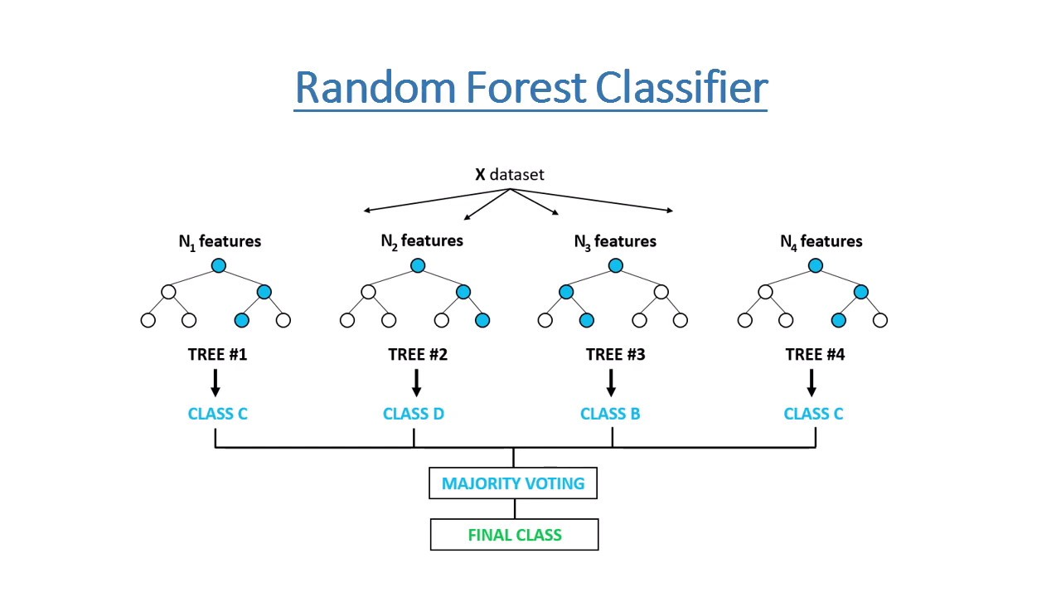
https://tinyurl.com/372jj8jc

Slide 10
K-means
Goal: partition the data into K distinct, non-overlapping subgroups (clusters)
Algorithm
Initialize: Choose K initial centroids randomly from the data points.
Assign: Assign each data point to the closest centroid, thus forming K clusters.
Update: Recalculate the centroids as the mean of all points in the cluster.
Repeat/terminate: Repeat the assignment and update steps until the centroids do not change significantly, or a maximum number of iterations is reached.

Slide 11
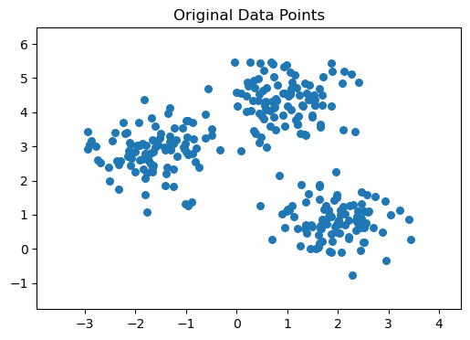
K-means

Slide 12
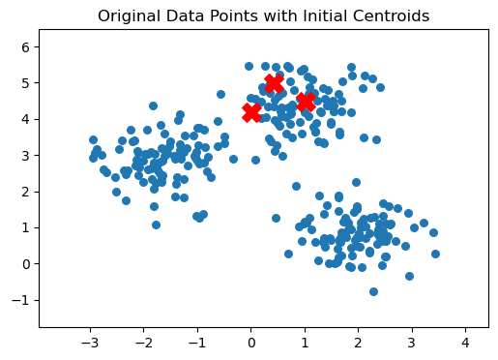
K-means

Slide 13
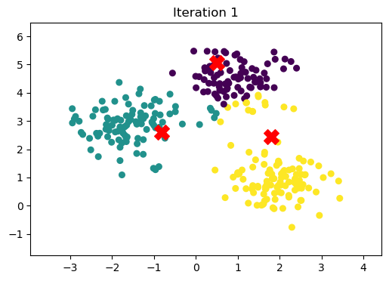
K-means

Slide 14
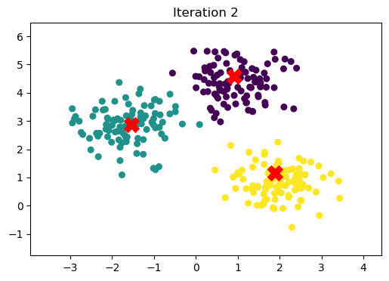
K-means

Slide 15

K-means

Slide 16

K-means

Slide 17

K-means

Slide 18
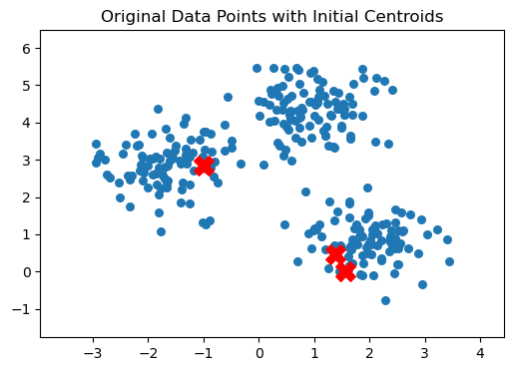
Problem: bad initialization

Slide 19
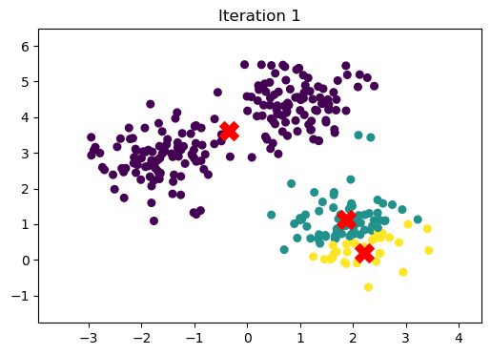
Problem: bad initialization

Slide 20
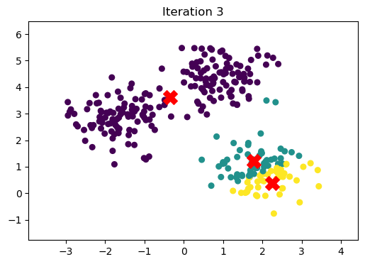
Problem: bad initialization

Slide 21
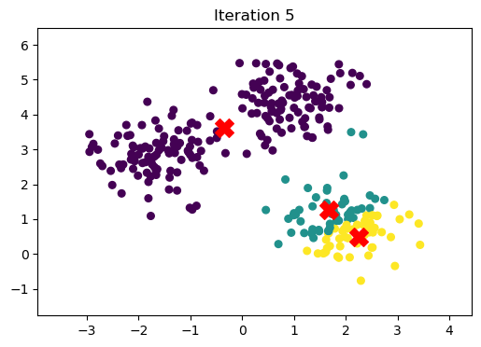
Problem: bad initialization

Slide 22
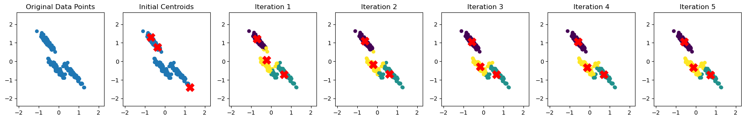
Problem: shape of clusters

Slide 23
Gaussian Mixture Models
Probabilistic model used for representing normally distributed subpopulations within an overall population.
Goal: model complex data distributions by representing them as a combination of several Gaussian distributions, each characterized by:
mean (μ),
variance (σ^2),
weight (which indicates the proportion of the population represented by each Gaussian component).
How? The parameters (means, variances, and weights) of the GMM are typically estimated using the Expectation-Maximization (EM) algorithm.
More details in jupyter notebook.

Slide 24
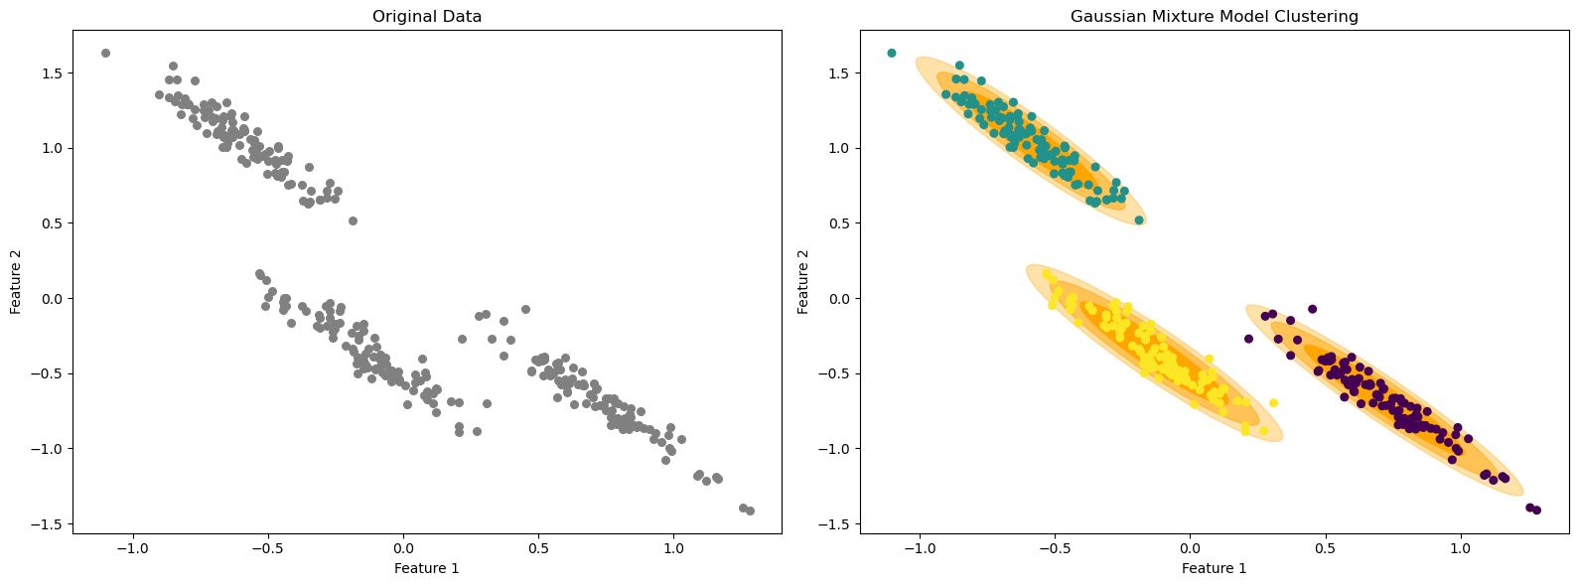
Gaussian Mixture Models

Slide 25
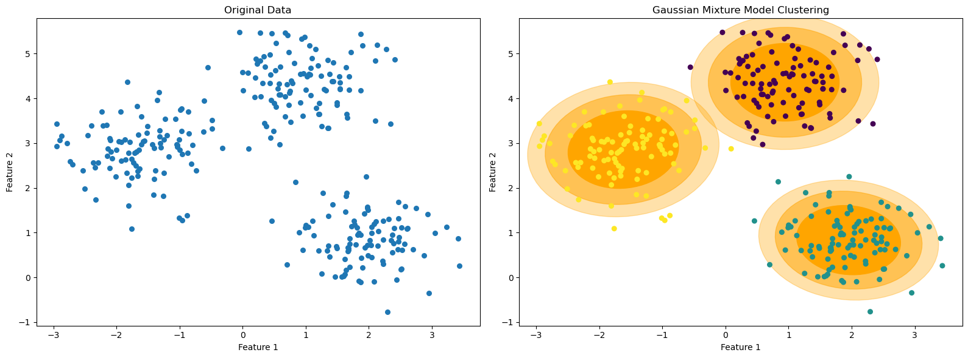
Gaussian Mixture Models

